Slide 1


Cloning, Migrating and Promoting Content with the API for Python
ESRI DEVELOPER SUMMIT 2023
Dan Yaw
John Yaist

Slide 2

Slides and Notebooks – will be available!
After the Event!
Esri Proceedings site - Slides
ArcGIS API for Python Public Repo – Notebooks
https://github.com/Esri/arcgis-python-api
On the conference_talks in the talks directory

Slide 3
Target Audience
Making Assumptions that you:
use Web GIS organizations in some capacity
work with Web GIS content and know its terminology
want to know of options to automate moving content between organizations
Python syntax and structures

Slide 4
Agenda
Moving Content - Reasons
Demo –
Cloning: Hosted Feature Layers and Web Maps
Inspecting the clone_items() method
Demo – Cloning Instant App
Other Methods to move content
Group Content Migration
Items and item data
Demo – Moving an Item and its Data
Troubleshooting

Slide 5





Staging
Production
Staging
Dashboard
Dashboard
Apps
Apps
Apps
Desktop
Desktop
Desktop
Webmap
Webmap
Webmap
Webmap
Webmap
Story Map
Webmap
Story Map
APIs
APIs
APIs
Layers
Layers

Slide 6
Demo: Cloning Feature Layers and Web Maps

Slide 7
Accessing the function
Content Manager

Slide 8
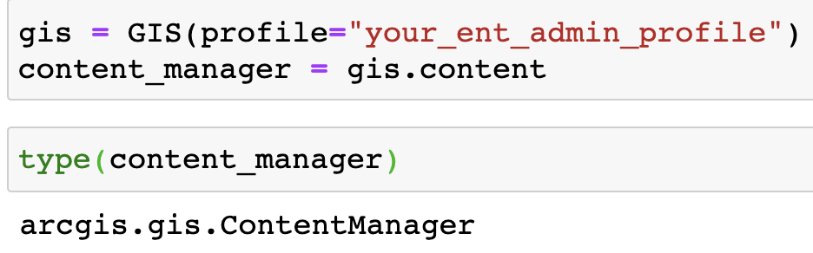
ContentManager
Accessed from the content property of a GIS object
clone_items() is a method on the ContentManager
https://developers.arcgis.com/python/api-reference/arcgis.gis.toc.html#arcgis.gis.ContentManager.clone_items

Slide 9

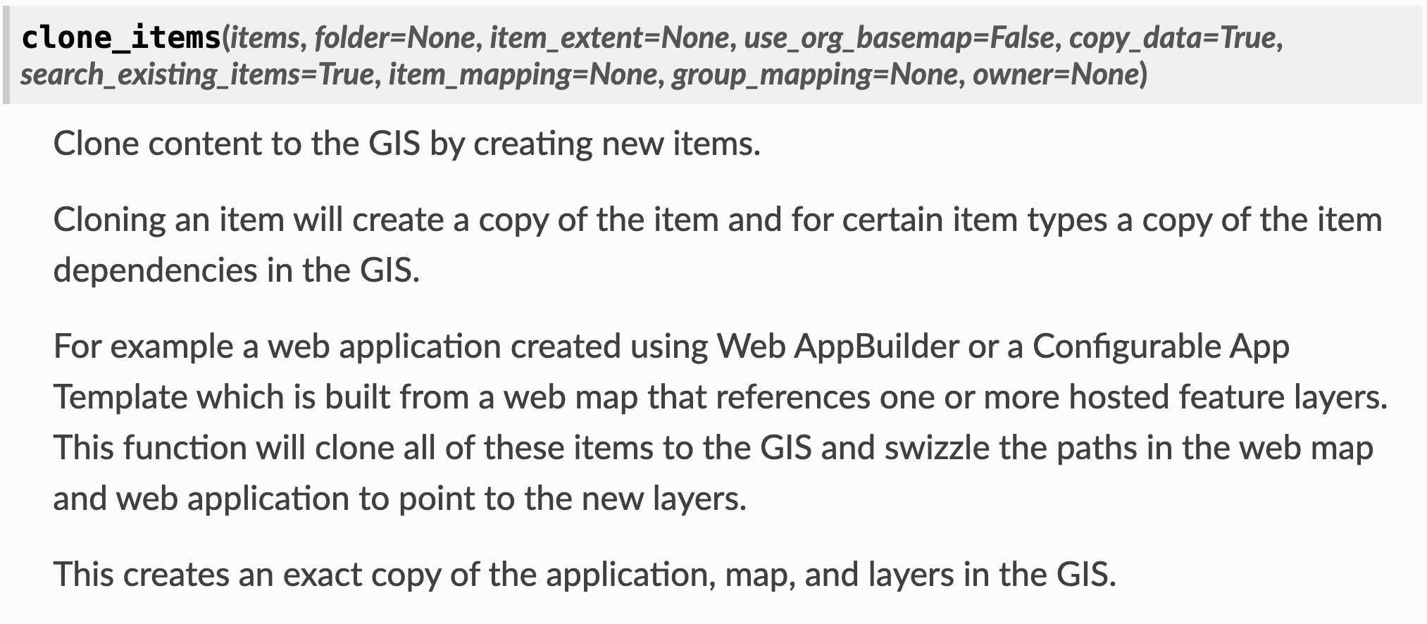
clone_items()

Slide 10
Key Parameters
search_existing_items
default value = True

Slide 11
search_existing_items
uses the item typeKeyword property to label result
cloned items have a typeKeyword formatted like below added:
source-<itemId>
example: Feature Layer item id e9541fd18bdc439dbf84ef7e929475ac.
cloned item typeKeyword: source-e9541fd18bdc439dbf84ef7e929475ac

Slide 12
Demo: Cloning an ArcGIS App

Slide 13

Additional Methods for Moving Content
GroupMigrationManager
Using Item Data

Slide 14
Additional Methods for Moving Content
GroupMigrationManager
Package Group Content to move between source and destination organizations
by default preserves Item Ids
Initialize manager objects from specific source and destination Groups
Workflow:
Create source package with content
Download package
Add package item to destination
Load package contents from item

Slide 15

Demo: Group Migration

Slide 16
Additional Methods for Moving Content
Using Item Data
An item’s data defines the structure of the item
Use the get_data() method to retrieve a json definition
Accessible as a Python dictionary
Control over how the item is recreated

Slide 17
Troubleshooting
Monitoring the Web Traffic

Slide 18


Logging Traffic

Slide 19
Conclusion
search_existing_items=True – prevents duplication of previously cloned items
Webmaps – Feature Layers are cloned by default
Feature Layers – data is cloned by default
Moving Items and Data provide additional control
Logging and monitoring Web Traffic provide insight
when methods fail

Slide 20





Connect With Us On Social
And Join the Conversation Using #DevSummit
twitter.com/EsriDevs
twitter.com/EsriDevEvents
youtube.com/c/EsriDevelopers
links.esri.com/DevVideos
github.com/Esri
github.com/EsriDevSummit
links.esri.com/EsriDevCommunity
#esridevsummit

Slide 21




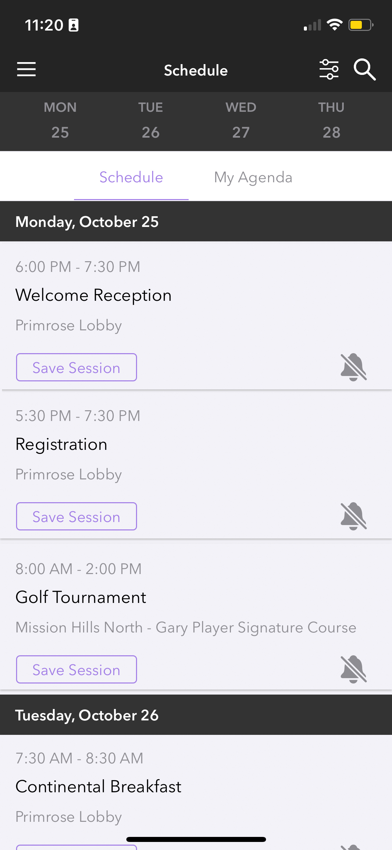
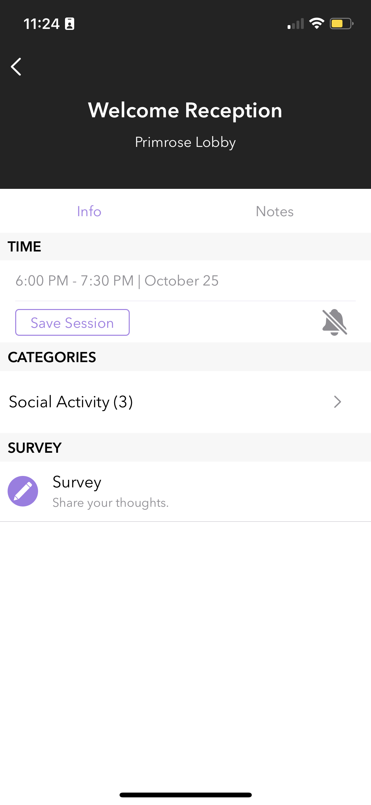
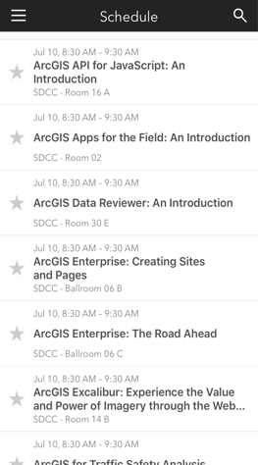
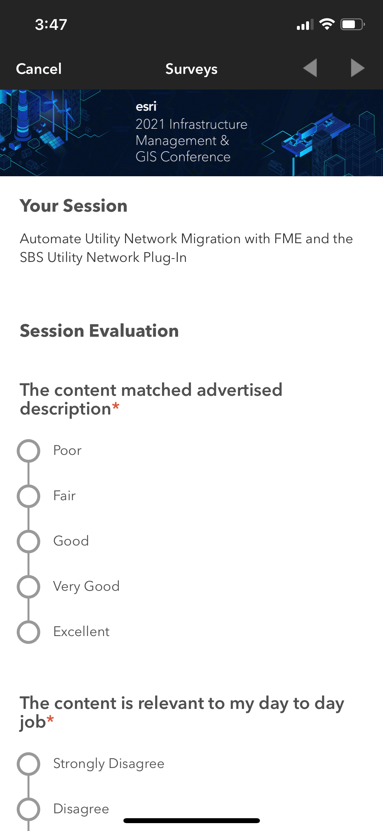
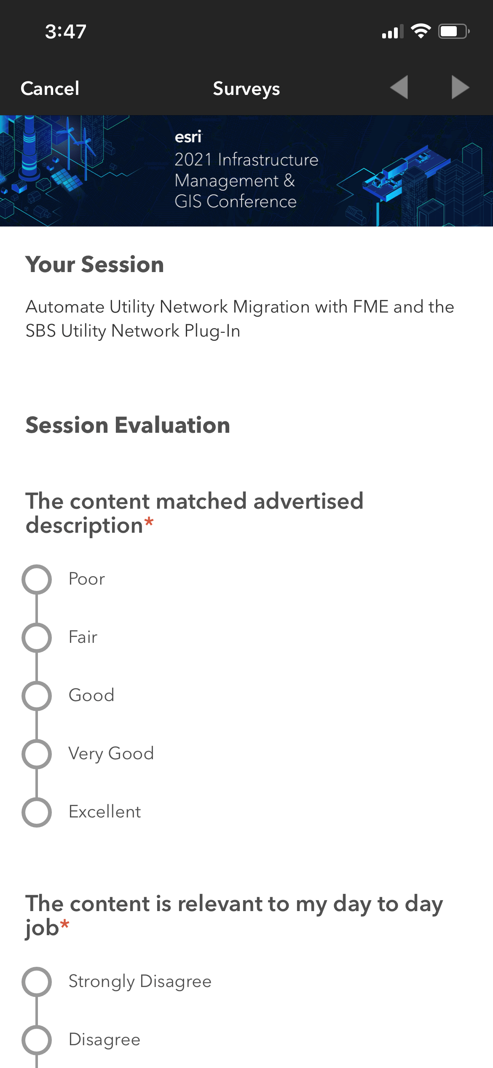
Please Share Your Feedback in the App
Download the Esri Events app and find your event
Select the session you attended
Scroll down to “Survey”
Log in to access the survey

Slide 22

Copyright © 2023 Esri. All rights reserved.

